Slide 1
Week #1 : Introduction

Slide 2
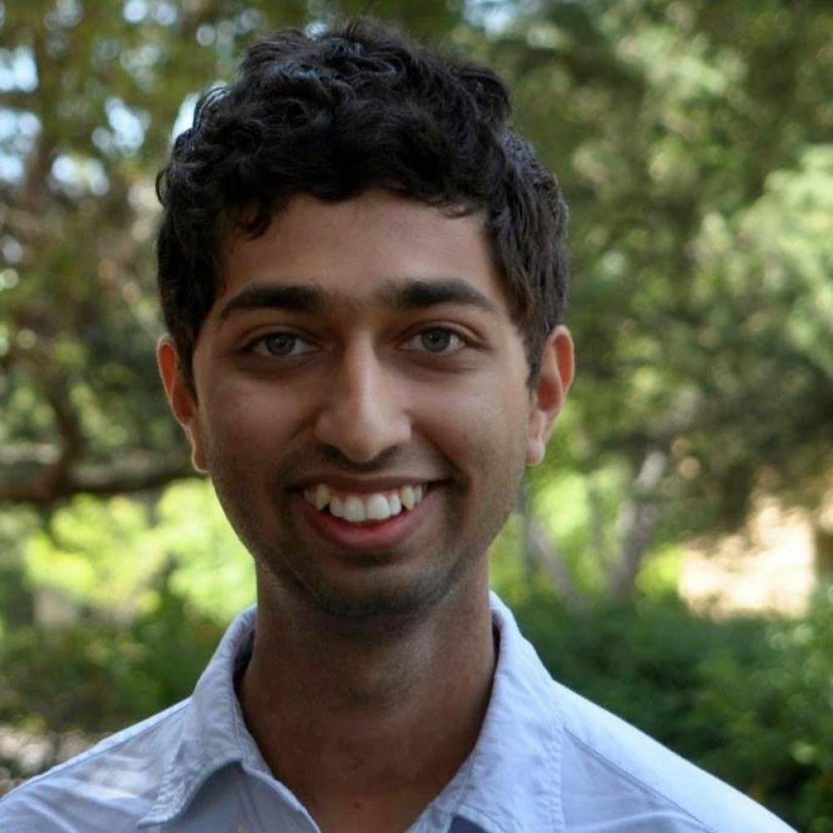
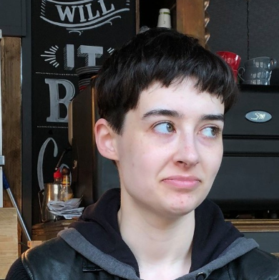
Who we are
Chinmay Kulkarni, Assistant Prof HCI
Studies and builds systems for large-scale learning, work, and mentoring.
Mary Beth Kery, 5th year PhD student HCI
Studies how people code with AI/ML and builds developer tools for experimentation.

Slide 3
Why we’re doing this course
Most AI/ML courses consider “user-interfaces” or human impact as an afterthought; and focus narrowly on algorithms

Slide 4
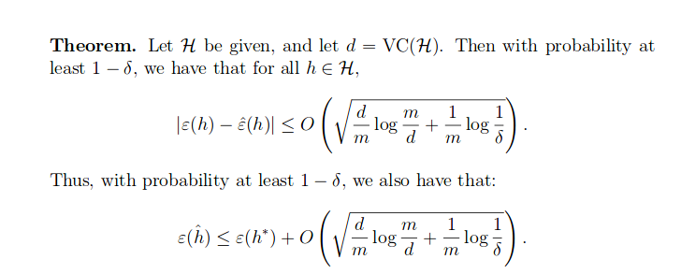
Chinmay’s personal experience with learning AI
Sep 2010: Third week of class.
I’ve used this beautiful mathematical result zero times for building interactive AI

Slide 5
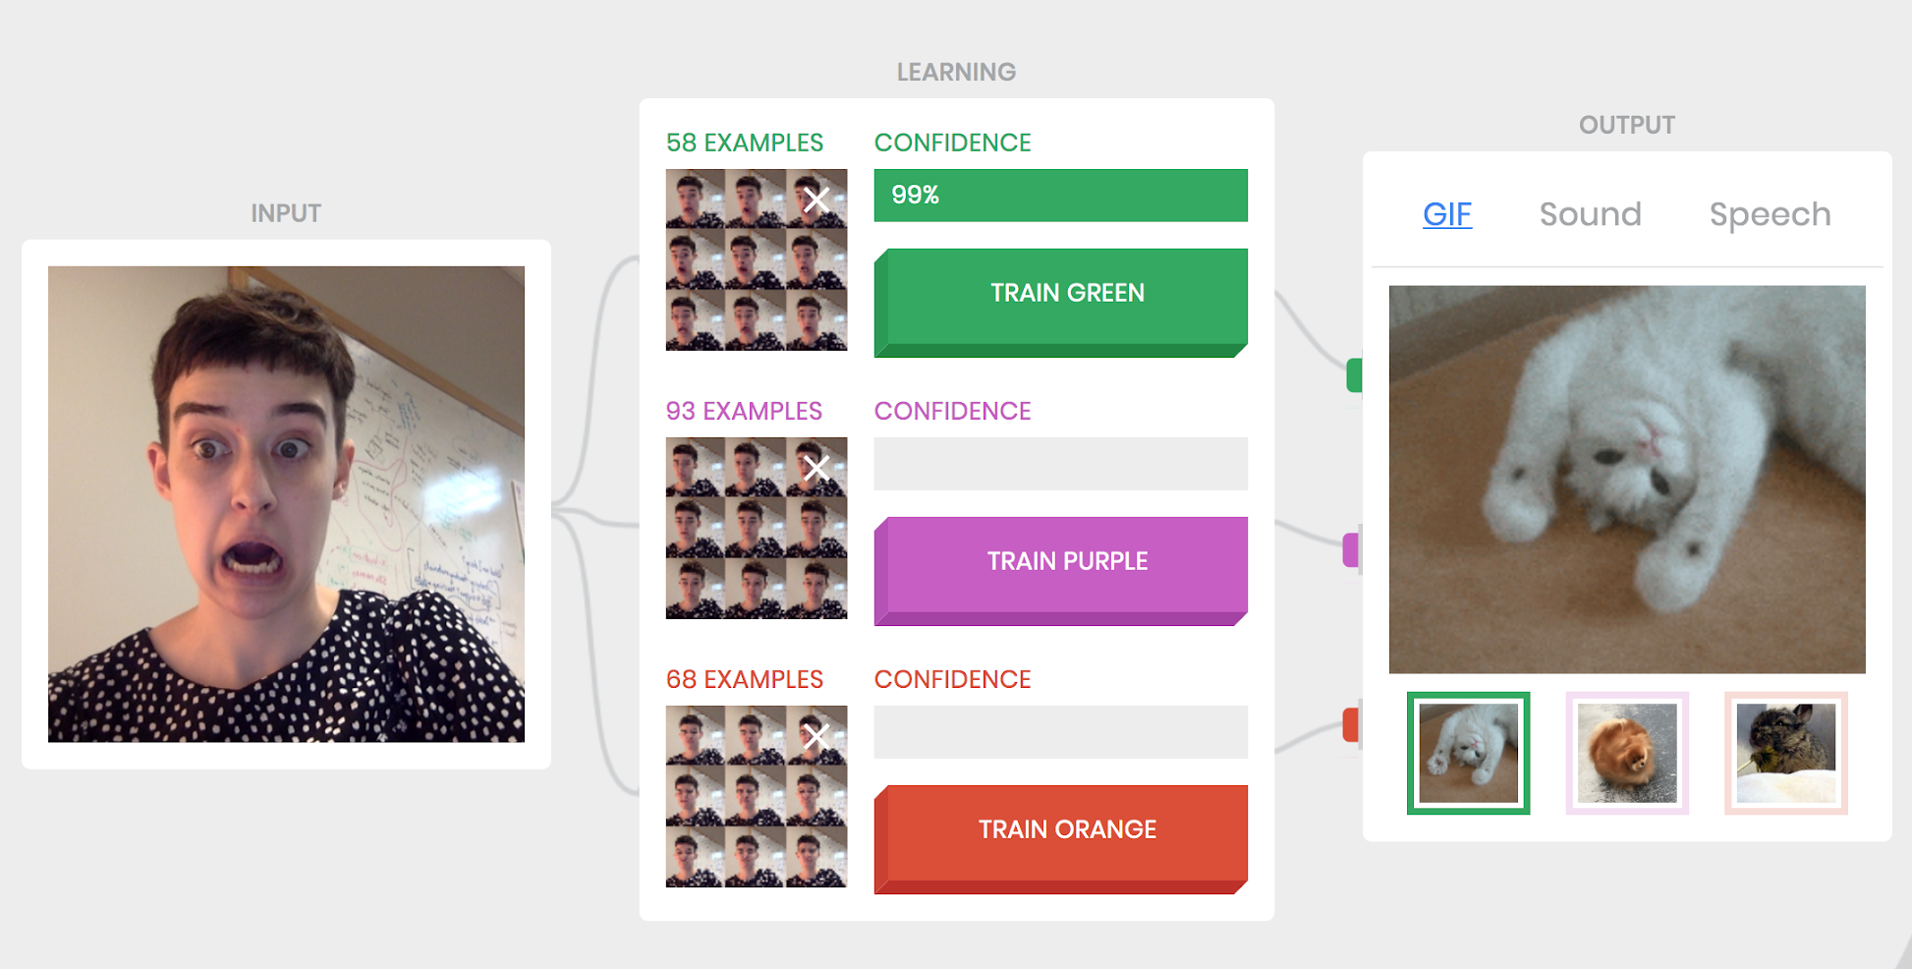
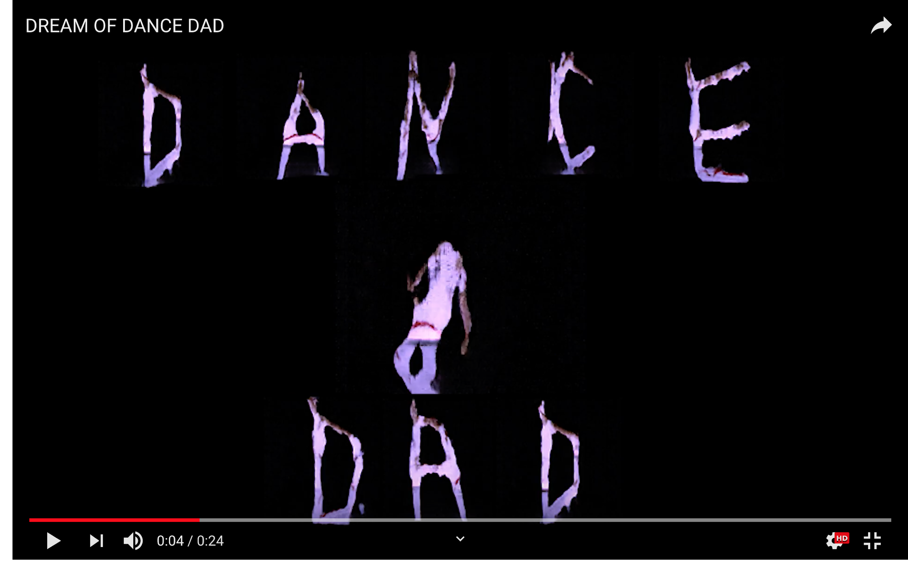
Mary Beth’s personal experience with learning AI
glitch art built on pix2pix + tensorflow
https://experiments.withgoogle.com/collection/ai

Slide 6
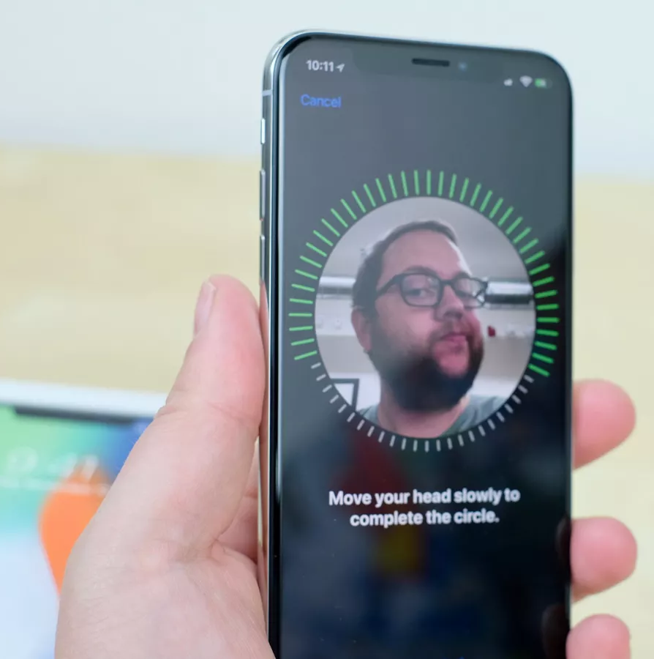
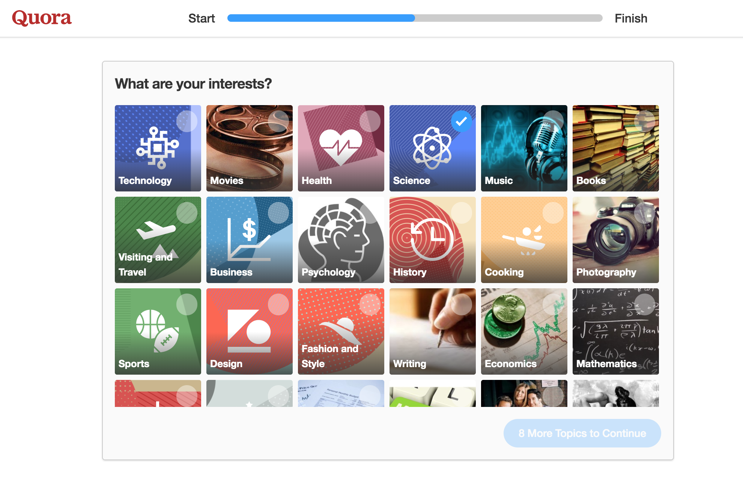
On the other hand, algorithms are not always the answer
Recommender systems: If you go to Netflix for the first time, what should it recommend you watch? [The cold start problem]
Mathematically, no one has solved the cold start problem with any meaningful guarantee. User experience design is critical to help overcome limitations.
Cold start Quora: Cold start iOS face id:
Notes:
Image: https://www.cnet.com/g00/how-to/apple-face-id-everything-you-need-to-know/?i10c.ua=1&i10c.encReferrer=aHR0cHM6Ly93d3cuZ29vZ2xlLmNvbS8%3d&i10c.dv=13

Slide 7
Why we’re doing this course
Human-AI Interaction Fall 19 .
Most AI/ML courses consider “user-interfaces” or human impact as an afterthought; and focus narrowly on algorithms
My experience at a startup: The only way to win is to cheat

Slide 8
Chinmay’s personal experience with AI startups
I have advised a few.
Most start with huge aspirations:
We will completely automate [PR, sales, customer service, driving…]
The technology seems to be there?
But too often, challenges arise:
Don’t figure out how to interact with people
Aren’t able to collect data
Etc.
The only way to win is to “cheat”: don’t think of the AI that can solve it all, but the human+AI team that will.

Slide 9
Why we’re doing this course
Most AI/ML courses consider “user-interfaces” or human impact as an afterthought; and focus narrowly on algorithms
My experience at a startup: The only way to win is to cheat
With you, we are co-inventing a new user-centric way to build AI systems

Slide 10

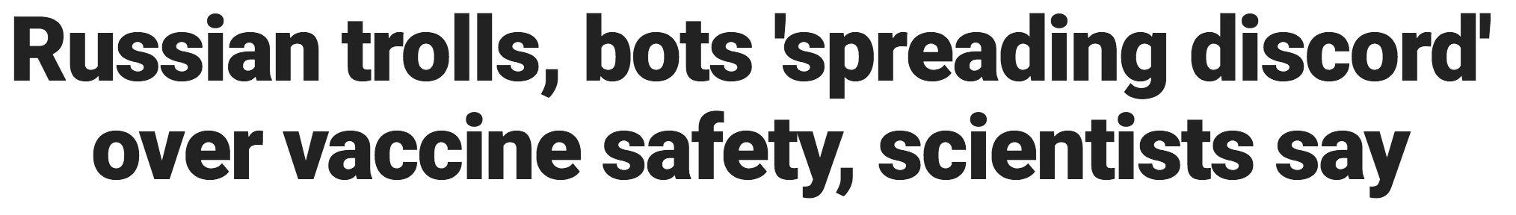
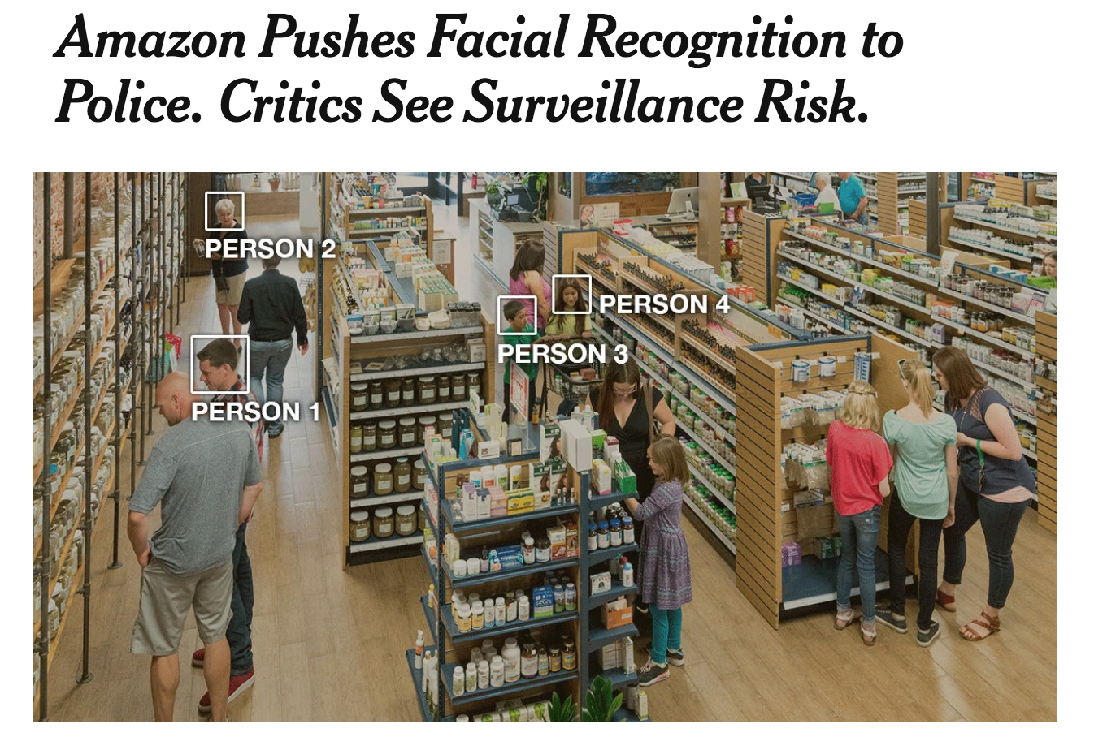
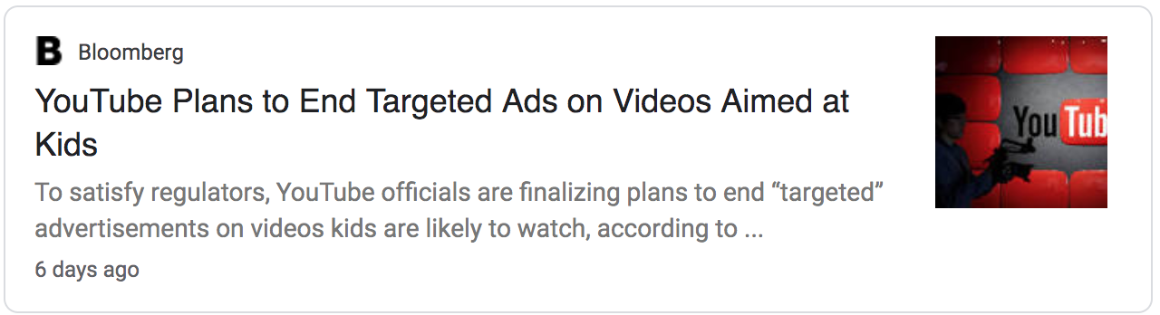
AI affects many facets of human life & society
Notes:
http://www.foxnews.com/tech/2018/08/26/russian-trolls-bots-spreading-discord-over-vaccine-safety-scientists-say.html
https://www.theverge.com/2016/3/24/11297050/tay-microsoft-chatbot-racist
https://www.nytimes.com/2018/05/22/technology/amazon-facial-recognition.html

Slide 11
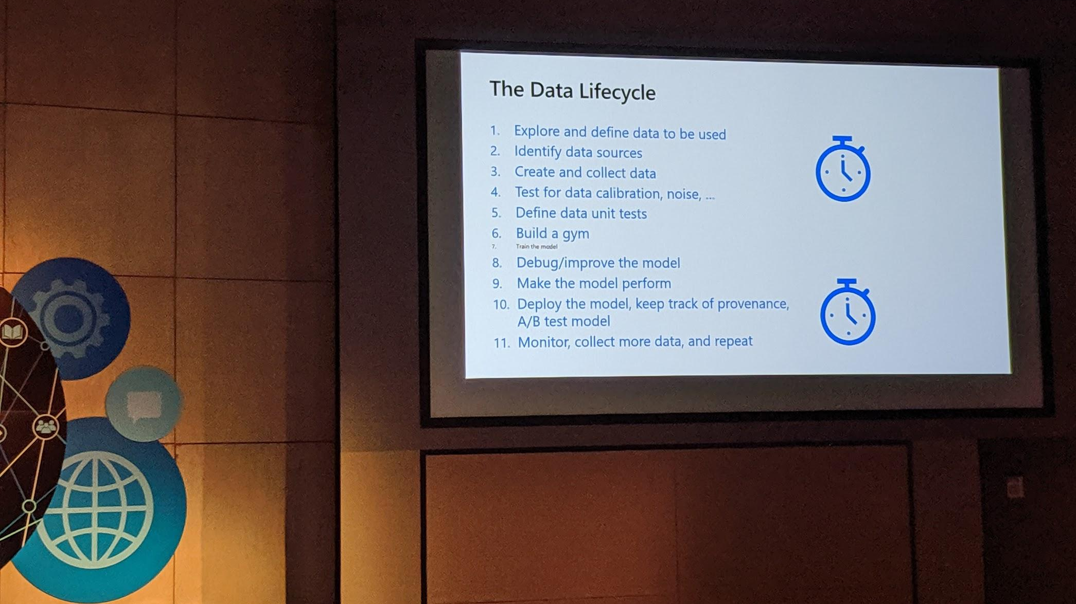
Earlier this year… (by the person leading Skype)
Good: train your model is tiny
Bad: where are all the humans???

Slide 12
Why we’re doing this course
Human-AI Interaction Fall 19 .
Most AI/ML courses consider “user-interfaces” or human impact as an afterthought; and focus narrowly on algorithms
My experience advising startups: The only way to win is to cheat
With you, we are co-inventing a new user-centric way to build AI systems - let’s do it!

Slide 13
Our teaching philosophy
Put people first!
AI/interaction NOT from the basics
Instead, we will use building blocks which are easier to reason about. Don’t worry -- these building blocks are state of the art!
When we talk about algorithms, we will anthropomorphize: e.g. linear regression just wants to draw a line in the sand. Logistic regressions wants to pick a zero or one, and is unhappy in the middle. Given a lot of choices, Softmax just wants to pick one.
It’s weird but effective.
We’ll help you think it through, but also “do it through” development
Nothing gives you a sense of possibilities and limitations like building it
To learn something, teach it
True in general, but for AI, industry folks have all sorts of ideas (often wrong).
To succeed, you need to teach them

Slide 14
What should you expect to do in this course?
Thinking it through: Readings, reflections, quizzes
Doing it through: Assignments and projects
Teaching it through: In class panel discussions, debate, etc.

Slide 15
Doing it through: projects
Assignment 1: build a system to determine if someone should get a mortgage, see how well it works, and for whom
Assignment 2: Build UI around mortgage system
Assignment 3: Visualize data that goes into an AI system. See why it matters
Assignment 4: Build a chatbot to recommend stuff to you
Assignment 5: User-facing computer vision application
Final project: Make something cool and interactive with AI/ML (or write about how people use a particular AI/ML product)

Slide 16
Do you know enough programming?
You need to know some Javascript and Python
Example tasks:
Javascript: Click a button, show a modal
Python: Take data as a csv, and transpose all rows into columns

Slide 17
What questions do you have?

Slide 18
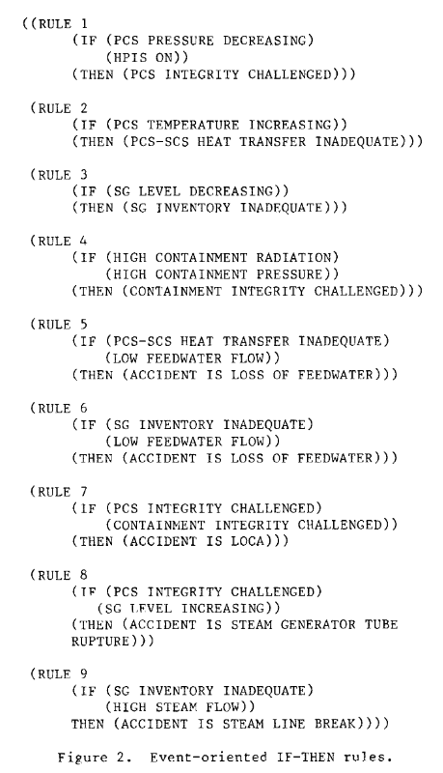
What do we mean by AI?
Computers doing things that we expect people to be able to do
Rule-based AI/expert systems: mimic an expert.
Planning/Solving: e.g. compute directions from CMU to IKEA.
Learning from examples: machine learning, computer vision, natural language processing etc.
Screenshot from http://www.aaai.org/Papers/AAAI/1982/AAAI82-070.pdf

Slide 19
Make it through
Create a journey map from getting lunch to coming to class. Where did AI come in, where did it not?
Where should it have? Where should it not?

Slide 20
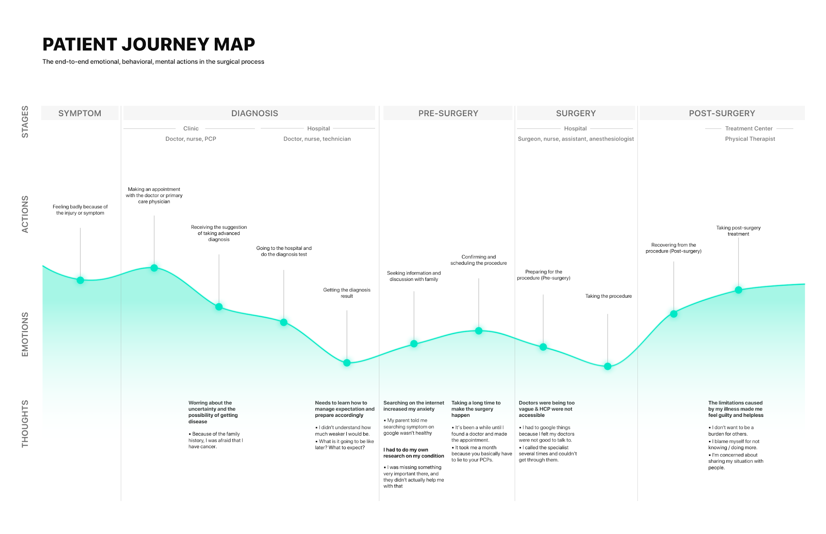

Slide 21
Journey map: What we’ll do now (Part 1)
(7 minutes) Make your own personal journey map -- alone
(3 minutes) Label on your map:
Where did AI come in?
Where should it have?
Where should it not have
(5 minutes) Discuss with 3-4 neighbors
What do you see as common themes?
How did your labels differ from others?
(5-8 minutes) Share with the class:
common themes
Major points of difference

Slide 22
Analysis (Part 2)
(4 minutes) Discuss: The common themes where AI does or should come in:
how might it fail?
What concerns do you have?
(4 minutes) Alone: How might you fix one of these concerns
Can you create a purely technical solution?
Can you create a solution part-technical, part people?
(5 minutes) Discuss: Solutions
What do you see as common themes among solutions?
(5-8 minutes) Share with the class:
common themes
Unsolved challenges

Slide 23
Affinity diagram (Part 3)
(10 minutes) Come up to the whiteboard, put up post it notes for your solution:
Challenges: Ethics, privacy, transparency, oversight, etc.
Technical issues: How to present to users, how to collect data, how to evaluate, how to handle failures, etc.
Applications: Recommender systems, natural language processing/understanding, computer vision, humans-in-the-loop, etc.

Slide 24
Course trajectory
Week 1-2: Orientation, and historical perspectives
Week 3-6: How to interact with users, how to collect data
Week 5-9: The big societal questions: ethics, data privacy, and more.
Week 10-15: Specific application areas: Recommendations, NLP, Vision, etc.

Slide 25
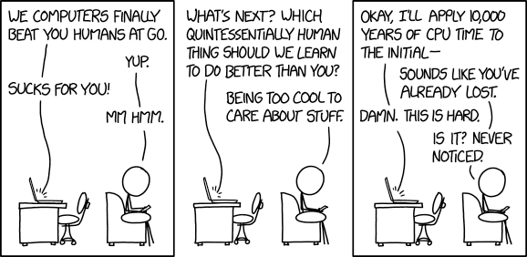
One more thing
Office hours for Chinmay: Prefer Monday or Friday?
What other questions do you have?

